Slide 1

Futures Institute
Year | Avg. | Total
2010 | 2.0 | 1.3 M
2015 | 2.2 | 1.5 M
2020 | 2.5 | 1.9 M
Track20 Activity update
Emily Sonneveldt
31 July 2013

Slide 2

Established M&E working group
Measurement and reporting for FP2020
Strengthening BkkbN information systems, analysis and dissemination

Slide 3
Recent and near future activities
Mapping indicators and data sources
Verify FP2020 baseline core indicators (2012)
Estimating FP2020 2013 core indicators
Establishing strategy for future estimates
Consensus building
System assessment

Slide 4
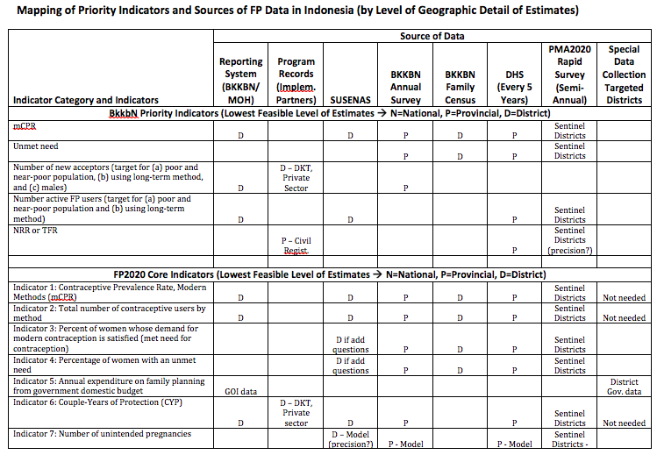
Mapping indicators and data sources

Slide 5
Verify FP2020 baseline core indicators (2012)
One day workshop
Based on 2012 DHS
Reported to Reference Group meeting in April

Slide 6
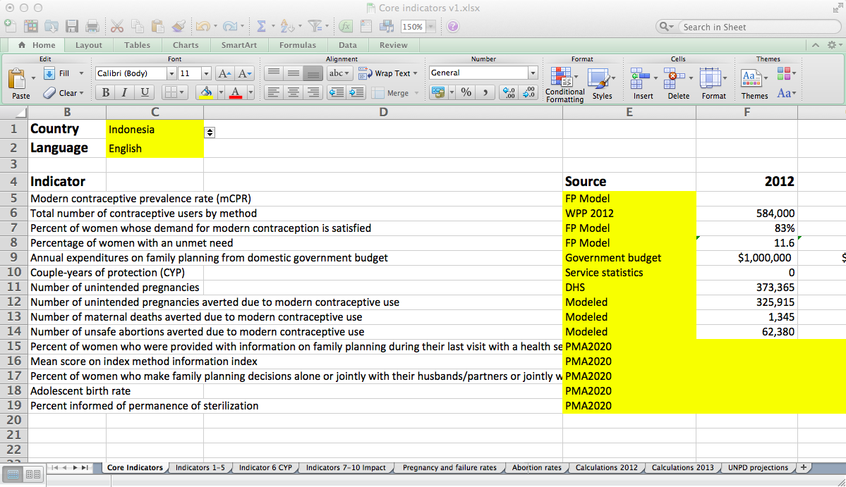
Estimating 2013 FP2020 core indicators

Slide 7
Consensus building
Develop consensus on the estimated values of core indicators
Half day workshop
National FP stakeholders
3rd or 4th week of June
Note: 2013 FP2020 indicators should be submitted on July 1st

Slide 8
Establishing strategy for future estimate
Source of data:
Susenas
PMA2020 survey results
BkkbN annual survey

Slide 9
BkkbN service statistics system assessment
Identify issues
Develop instruments
Field asssessment
Analysis and recommendation

